Slide 1
Dot Plots
Mr Parekh

Slide 2
Learning Intentions
Students will be able to
construct a dot plot given a data set.

Slide 3
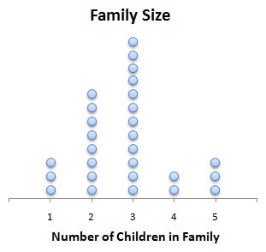
24
7
30
Displaying Data
Date:
EQ – What is a dot plot and how do I make one?
Displaying a data allows reader easily see the patterns in the data. Data can be displayed in dot plots, column plots, picture graphs etc.
What are dot plots?
Dot plots are constructed by putting a dot for each data item above a scale.
Each dot represents one data value.
How many families have 2 children?
What is the most common number of children in a family?
Summary:

Slide 4
24
7
30
Displaying Data
Date:
EQ – What is a dot plot and how do I make one?
How do I create a dot plot?
Example 1:
The following list shows ages of the students in the group:
12, 12, 13, 12, 12, 11, 12, 11, 12, 12, 11, 11, 12, 13, 12
Process:
Step 1 : Draw a number line from the lowest value to highest value. Leave room able the scale for the dots.
Step 2: Put dots for each number on the scale.
Step 3 : Label the number line
11
12
13
Age
Summary:

Slide 5
Task
Dr Dwyer textbook, pg 194, Exercise 14.5
Notes:
Guide students through the question.
Option 2: Dot plots handout (Scaffolded for kids who may need extra help)

Slide 6
Closure
Complete your summary

